Slide 1
Web Monitoring For Performance Regressions
João Leite
AE3
2021
Notes:
RUI?

Slide 2



BACKGROUND
Businesses
Individuals
Notes:
----- 30
This research flourished from the increasing reach of the internet and how crucial it is for both businesses and individuals to have online presence. Although most also use social media, most should also have a professional website, with basic information and their products or services. Same as in the real world clients have expectations, and that holds true for websites too, most users expect a good and easy to navigate design with fast loading times, but that can be hard to maintain, primarily when the website gets frequent updates or additions.
Because of increasing reach of the internet, businesses and individuals need an online presence to stay competitive. .When it comes to websites, users have certain expectation in regards to design, functionality and performance, and to help meet those needs they can use web monitoring so they can learn about user metrics as well as website performance and slowdowns experienced.

Slide 3
Research Question
How can Synthetic Transaction Monitoring systems be used to detect problems end-users encounter when navigating a page by looking into performance degradations in web services?
The project goal was to built a test harness to perform synthetic monitoring with focus on individual requests, analysing them to find the root causes of degradations found by users.
Notes:
----- 20
The project researched how Synthetic Transaction Monitoring systems can be used to detect problems users encounter when navigating a page by looking into performance degradations in web services. This was achieved by creating a test harness for synthetic monitoring with focus on individual requests, so analysis could be done to detect the root causes for performance degradations.

Slide 4
WHY
Bad User Quality of Experience
Reduced Profitability/Reach Potential
Web Monitoring
can cause
can be solved with
AN, D., 2017. Find out How You Stack up to New Industry Benchmarks for Mobile Page Speed Available from: https://www.thinkwithgoogle.com/marketing-strategies/app-and-mobile/mobile-page-speed-new-industry-benchmarks/
Notes:
----- 38
Like in a store, first impressions last, so as a website owner, you need to ensure the website is online and working as intended at all times. This is important as users often decide whether to chose a product/service based on their first experience.
The results of a study by Google in 2017, shows that increasing the page load time or number of resources will likely affect a site bounce rate negatively. This makes it so some companies can even see direct correlation between their website performance and business profitability. To reduce the chances of encountering problems, one can perform web monitoring.

Slide 5
BENEFITS
Availability
Performance
Finding Delays Root Causes
User Metrics
Notes:
----- 25
Different types of web Monitoring yield several benefits, first, their most common use cases are dynamically showing the website availability and performance, usually with graphs and charts.
Can be used to find the root causes of delays by looking at individual requests. And can gather user tailored data to improve user experience or marketing strategy.

Slide 6
Synthetic Transaction Monitoring (STM) Vs Real User Monitoring (RUM)
WEB MONITORING TYPES
Notes:
----- 40
There are two main ways to do web monitoring, STM and RUM. This project developed a STM, by simulating user behaviour in a webpage and recording transactions, the application can gather data consistently and is run from a controlled environment which makes it less likely be influenced by external factors. This makes it good for performance and availability monitoring.
RUM on the other hand, monitors real users behaviour which offers big potential for marketing purposes and well as a set of useful metrics such as, conversion rates, error rates, page views, task success, and others.
When used together the systems complement each other nicely.

Slide 7
Project Requirements
Functional | Non-Functional
Simulating end-user interaction with a website | Package application as containers
Running tests programmatically on a recurring basis | Deployment and hosting of application in the web
Saving simulation transactions to database | Programmatically detecting fundamental changes in page load times
Creating time-series visualisations for web monitoring | Programmatically detecting components causing page slowdowns
Developed
Not Developed
Notes:
----- 33
In this table there are the project requirements defined in the first phase of the project. The application developed is able to programmatically run synthetic tests by simulating user interaction with a page. Save the simulated transactions to a database and display them visually. For ease of use the application was also packaged as a container and hosted on the web. The last 2, the automation of problem detection and performance classifier unfortunelly were not developed
due to my limited current knowledge on the technologies.
Due to the learning curve present for chosen technologies, the automation of problem detection and performance classifier was researched but not developed.

Slide 8

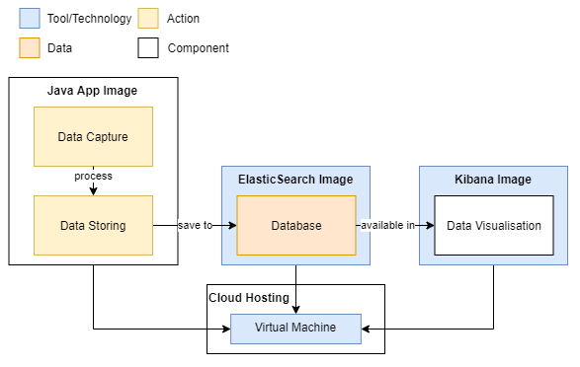

ARTEFACT DESIGN
Notes:
----- 21
Elaborating on the artefact arquitechture, it was separated in 4 parts as the diagram shows. Its composed by three docker containers hosted on the a virtual machine in cloud hosting. The application starts by simulating the user behaviour in the Java image using Selenium. The interactions are saved in memory, pre-processed and sent to the ElasticSearch, which can then be manipulated and visualised from Kibana.

Slide 9
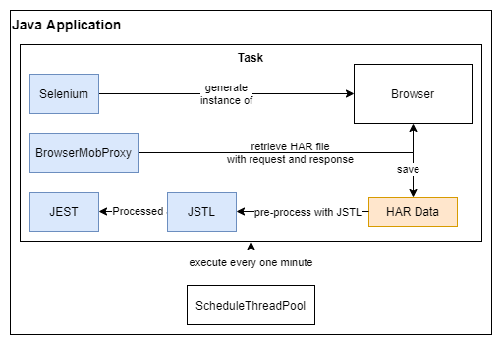

CAPTURING & STORING DATA
Notes:
----- 42
The diagram shows the process of capturing and storing data. It starts by repeatedly simulating user behaviour with Selenium tests. Its transactions are then captured using BrowserMob proxy and saved in memory until they are processed with JSLT. This language was used to dynamically transform the JSON data by cleaning the useless fields such as request and reponse text, and add useful metadata. This also separated the tests into individual transactions which made them easier to analyse and store. To send them, I’m using a library called Jest which is a HTTP client that acts as a interface for the ElasticSearch APIs.

Slide 10
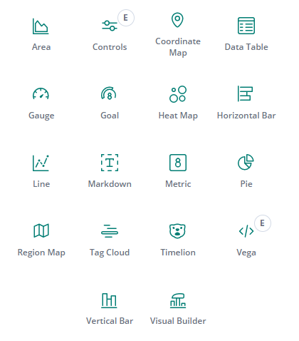

Data Visualisation
Notes:
----- 22
The data visualisation was done using a selection of panels in Kibana. For this project it was crucial to display data in time series graphs that could represent the website availability and performance over time. Other visualisations were also added with the purpose of problem detection as well as to generate metrics of comparison to test the application usefulness.

Slide 11
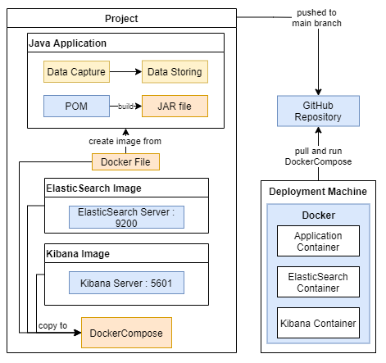


DEPLOYMENT
Notes:
-----44
The Final part was the deployment of the application to a virtual machine in Microsoft azure, the diagram represents the three images that form the application, and in specific how the application is packaged. As you can see the Java app is compiled into a JAR file, and copied to a docker image with the required tools (firefox and geckodriver). That image is used within a DockerCompose file that gets the official images for ElasticSearch and Kibana.
When there were significant developments, the application was pushed to GitHub so it could be pulled from the virtual machine. Finally the program was started in the virtual machine and made available with a public DNS.

Slide 12
VALIDITY TESTING
Tests
Calculating Accuracy
Long Time Monitoring
Problem Detection
Findings
77% Accurate
Problem with long tests
Injections Detected
Notes:
-----45
The artefact was tested 3 different ways
The first test to compare the artefact results against other web monitoring tools and giving them a score based on their relative standard deviation. This test resulted in 77% accuracy against the compared tools.
The second one was trying to use the application for long periods of time. Which during development was repeatedly causing problems, with both, failed tests and the application stopping between the 3 to 6 days range.
The final one was to inject performance regressions in a monitored test website. The analysis showed that the injections could be easily identified through the graphs, and further analysis could point the requests causing major delays in the page.

Slide 13
Conclusions
Accurate for Load Time Monitoring
Good Overall Consistent Performance
Problem while Monitoring for Long Time Periods
Can and Should be Expanded
Notes:
-----27
My final conclusions are that the application can accurately monitor a website load time but is not precise for the page size.
In general it showed consistent overall performance with equal intervals between tests. Unfortunely, the java docker image stops after a few days and the cause was not found.
The application still needs some improvements on the existing features but is in a good place to be expanded.

Slide 14
Demo - 1 MIN

